Slide 1
Basic Information on Bioenergy 2026
xx.xx.2026

Slide 2
Content
Bioenergy in Finland 3​
Bioenergy in the EU 14​
Bioenergy in the world 21

Slide 3
​
Bioenergy in Finland

Slide 4
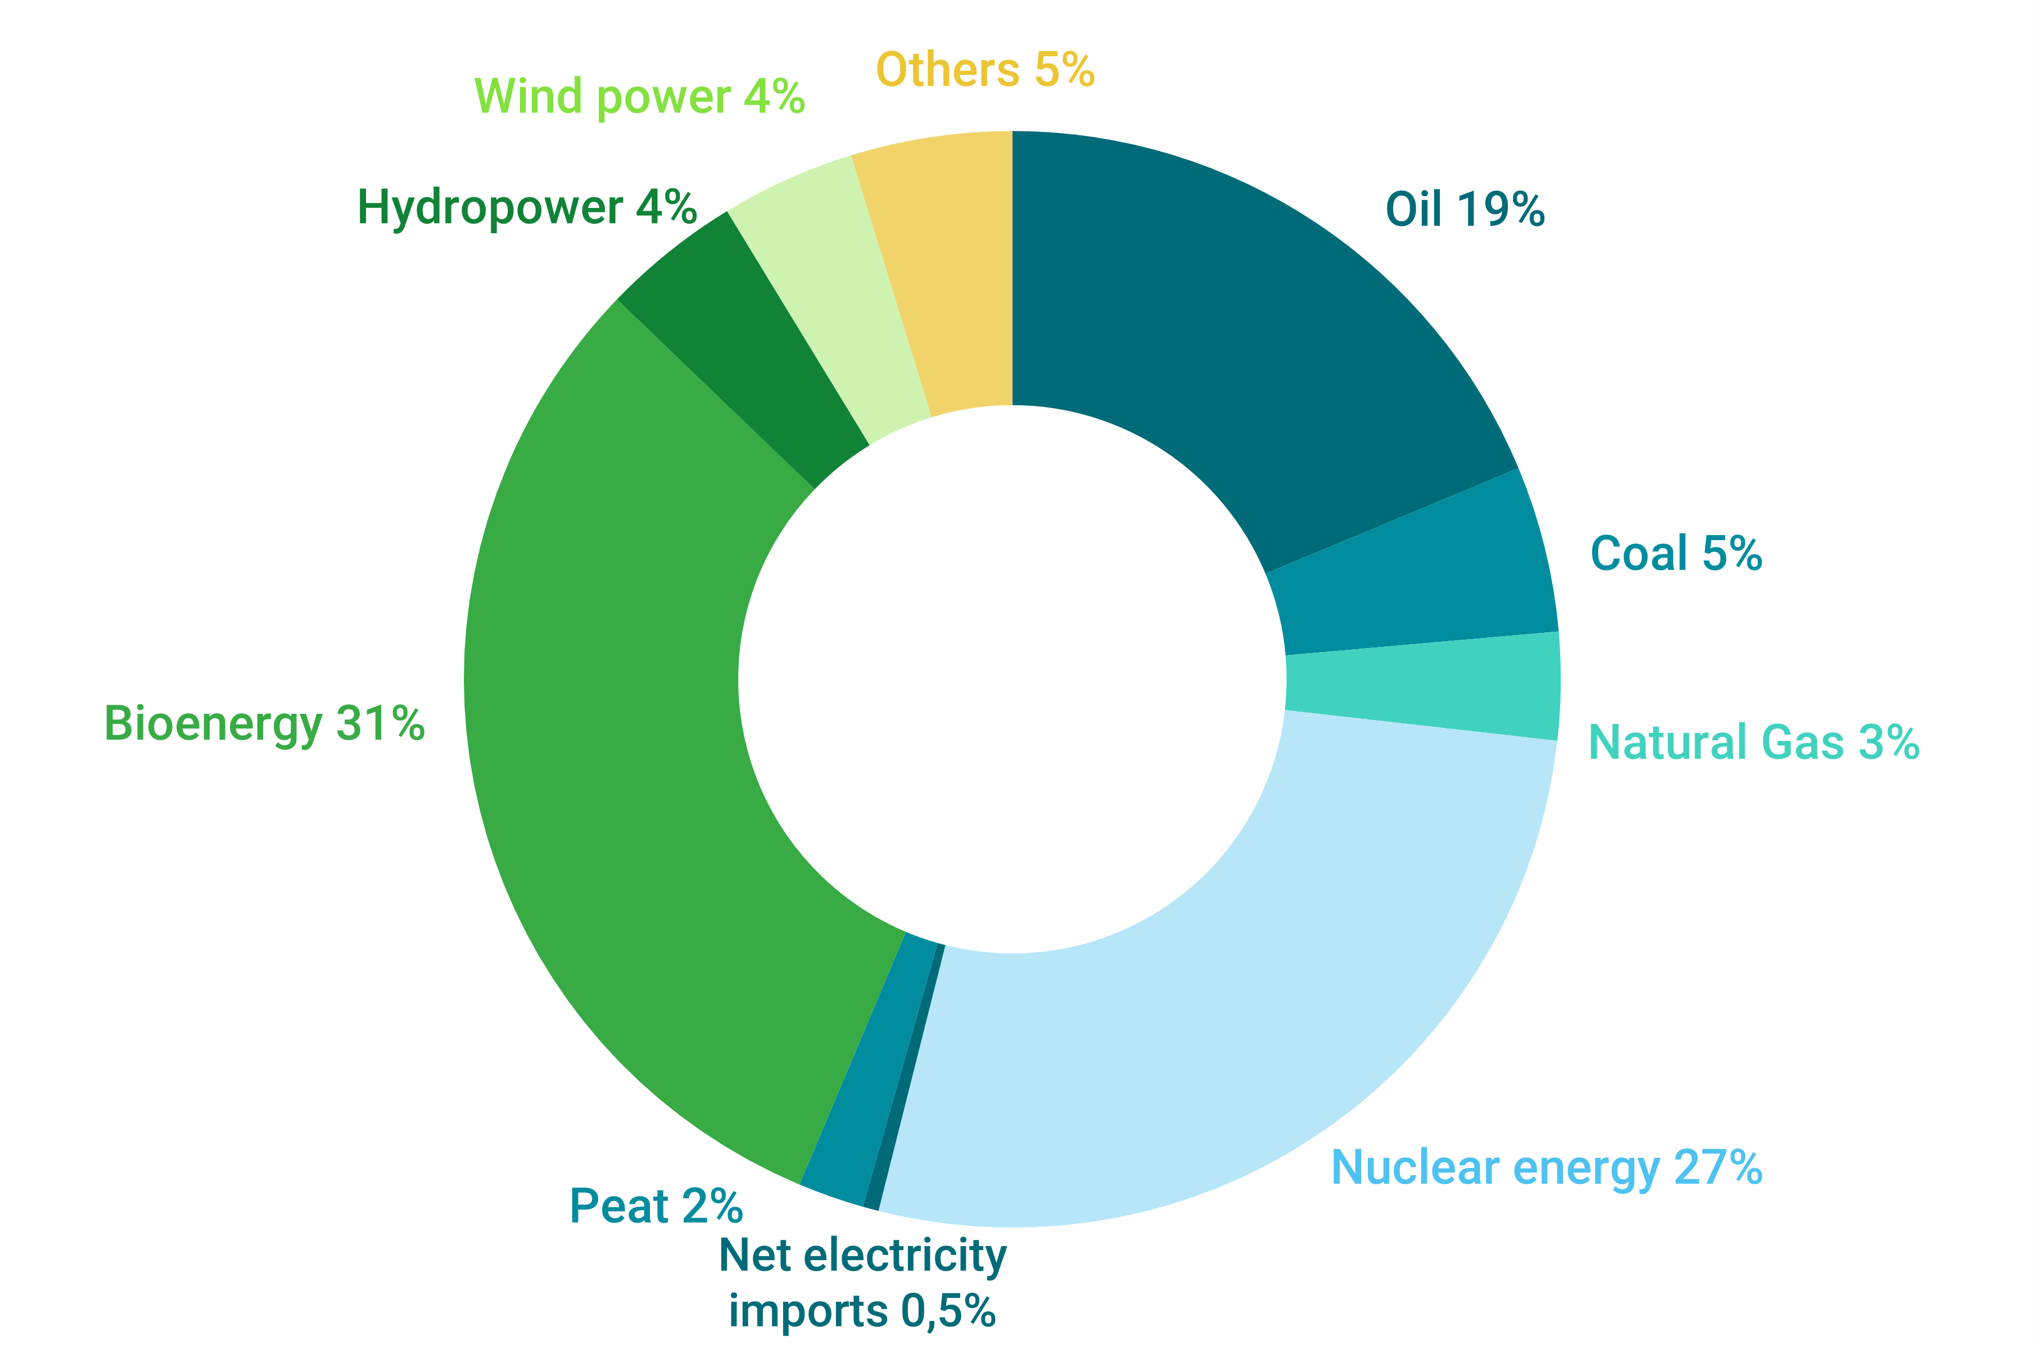
Energy Consumption in Finland 2024
Source: Statistics Finland, 2025

Slide 5
Bioenergy in Finland 1970–2024
Source: Statistics Finland, 2025

Slide 6
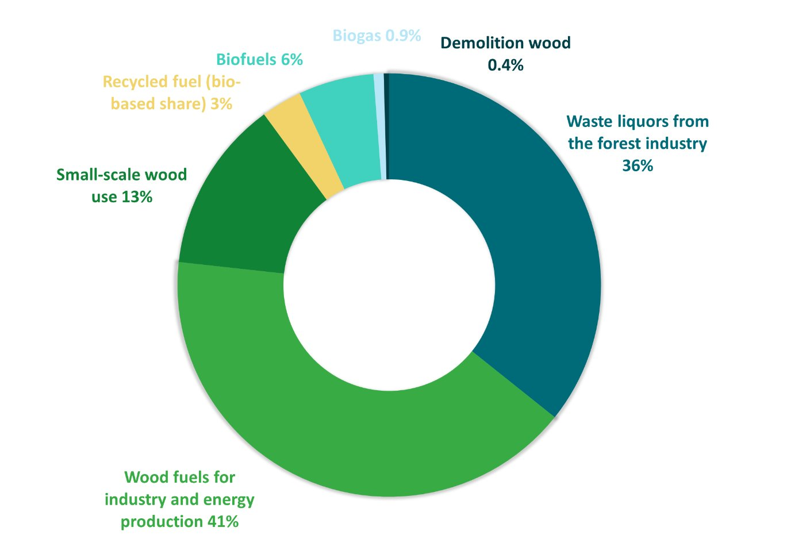
Bioenergy in 2024
Source: Statistics Finland, 2025

Slide 7
Bioenergy per Type 1970–2024
Source: Statistics Finland, 2025

Slide 8
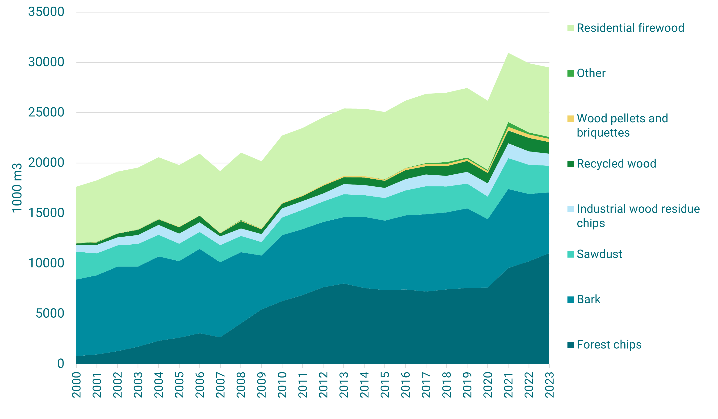
Solid Wood Fuels per Type 2000–2024
Source: Natural Resources Institute Finland, 2025

Slide 9
Bioenergy in Transport 2002 – 2025
Source: Statistics Finland, 2026

Slide 10
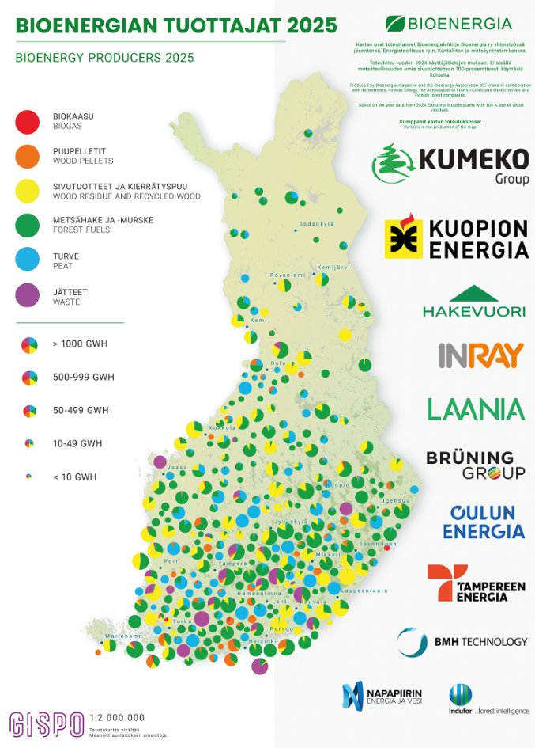
Check out the map:
bioenergia.fi/bioenergiantuottajat

Slide 11
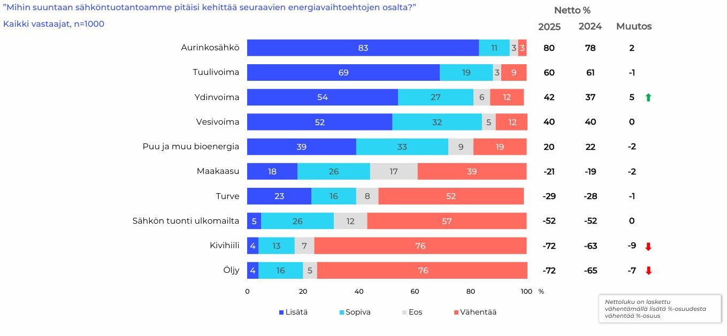
Development of Electricity Production
Source: IRO Research, 2025, Suomalaisten energia-asenteet 2025

Slide 12
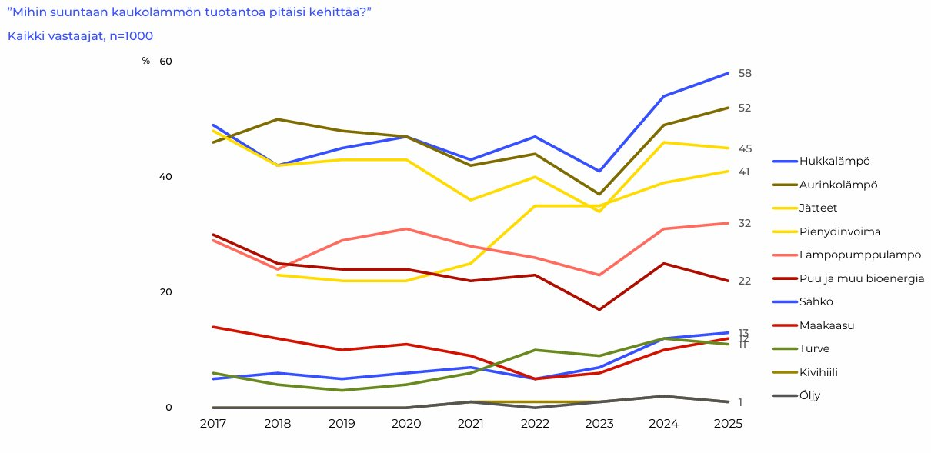
Evolution of District Heating Production
Source: IRO Research, 2025 Suomalaisten energia-asenteet 2025

Slide 13
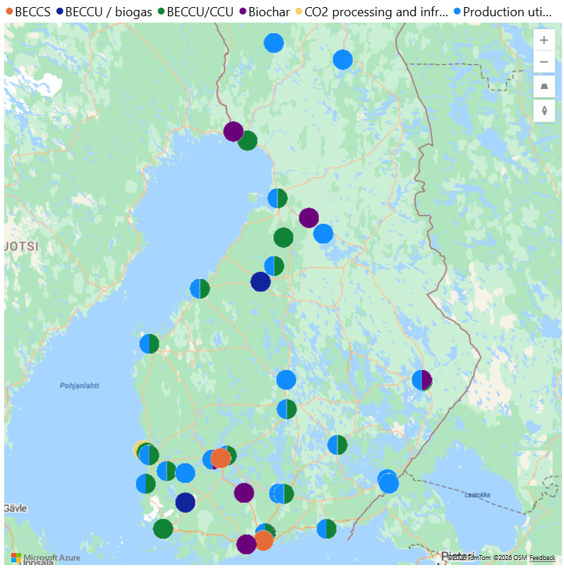
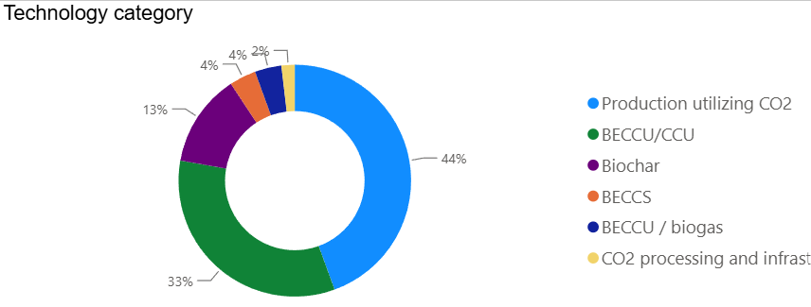
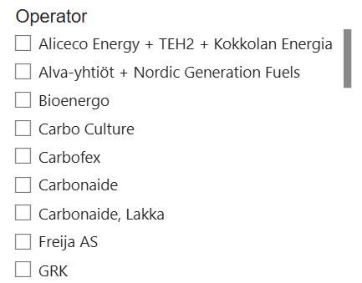
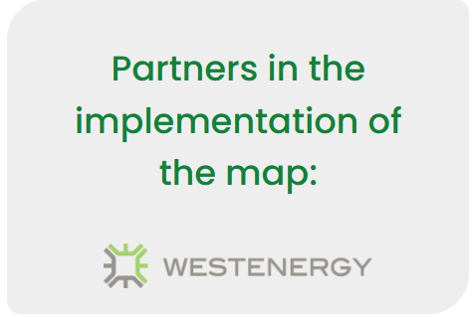
Projects on the Map: Bio-CCUS & Biocoal
bioenergia.fi/bio-ccus-ja-biohiili
Check out the map:
Bio-CCUS & biochar – Bioenergia ry

Slide 14
Bioenergy in the EU

Slide 15
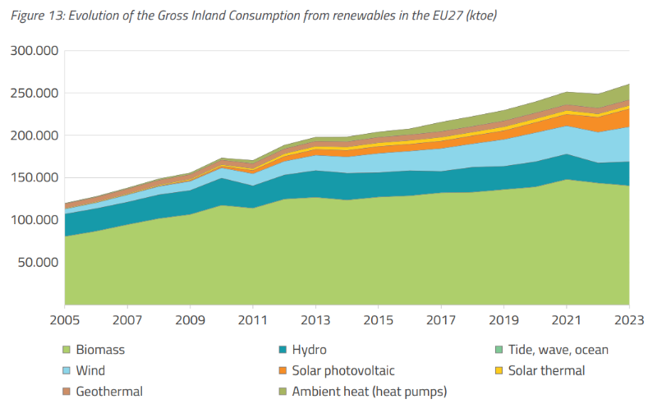
Evolution of the Renewable Energy Consumption in the EU 2006 - 2023
Source: Bioenergy Europe, 2025, Report Bioenergy Landscape

Slide 16
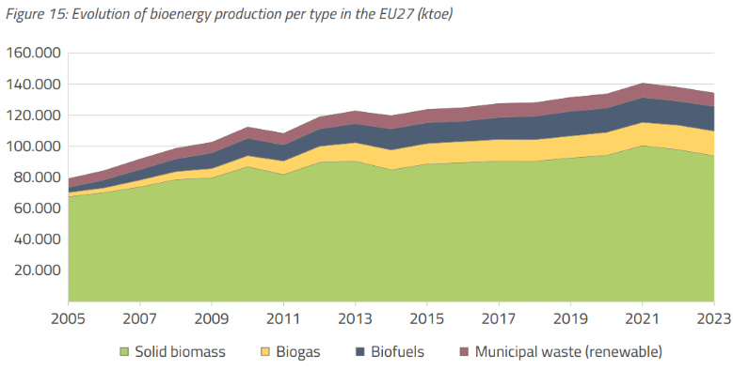
Evolution of Bioenergy Production 2006 - 2023
Source: Bioenergy Europe, 2025, Report Bioenergy Landscape

Slide 17
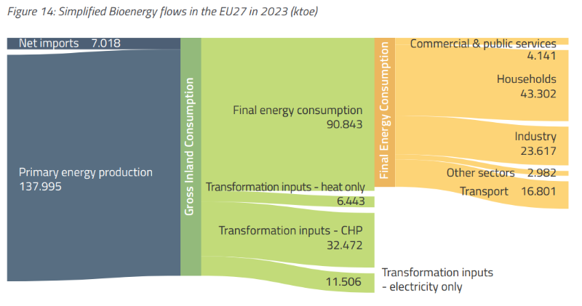
Bioenergy Balance in the EU 2023
Source: Bioenergy Europe, 2025, Report Bioenergy Landscape

Slide 18
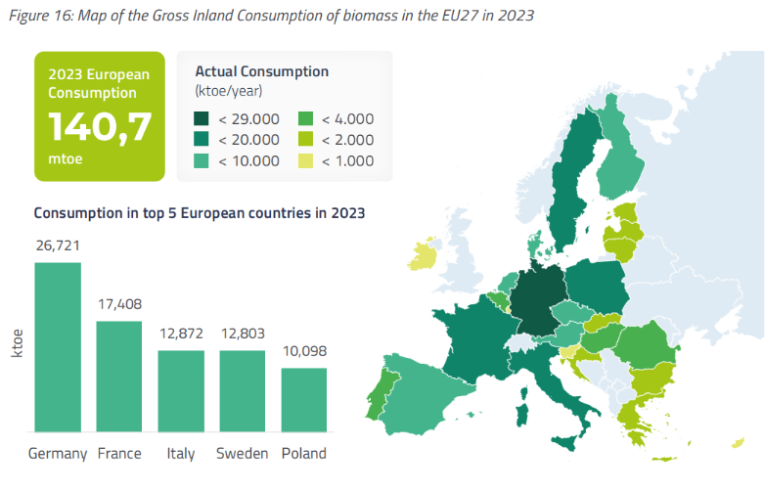
EU – the Largest Users of Bioenergy in 2023
Source: Bioenergy Europe, 2025. Report Bioenergy Landscape

Slide 19
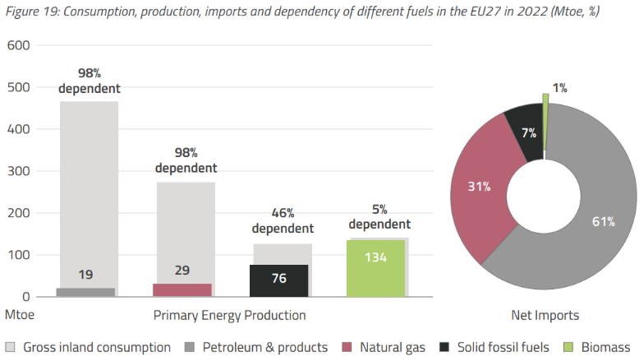
Bioenergy is Mainly Domestic Energy Source in the EU
Source: Bioenergy Europe, 2025, Report Bioenergy Landscape

Slide 20
Bioenergy in the World

Slide 21
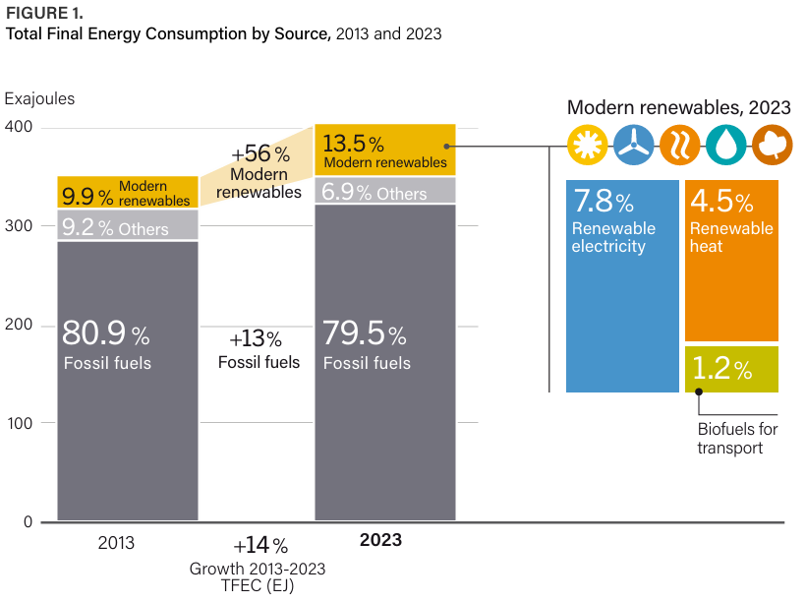
The Growth of the Renewable Energy
Source: REN21, 2025, the Renewables 2025 Global Status Report (GSR)

Slide 22
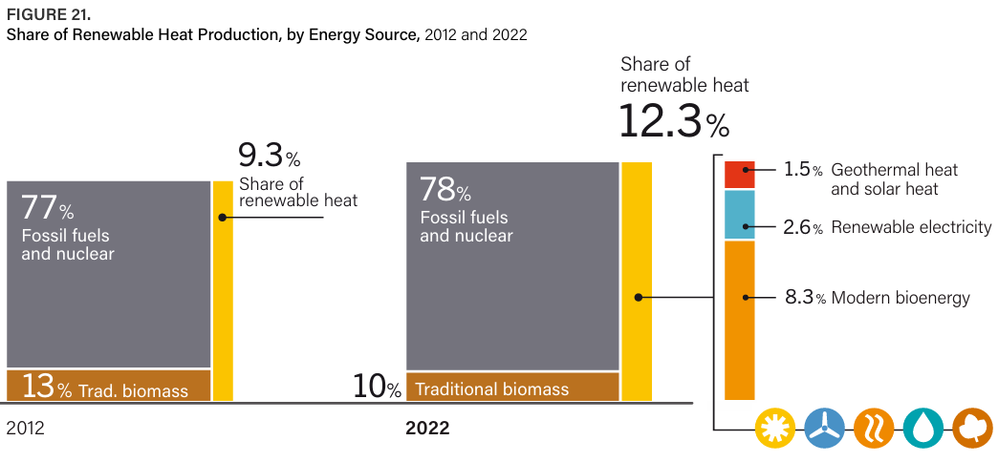
Bioenergy has a Major role in the Heating Production
Source: REN21, 2025, the Renewables 2025 Global Status Report (GSR)

Slide 23
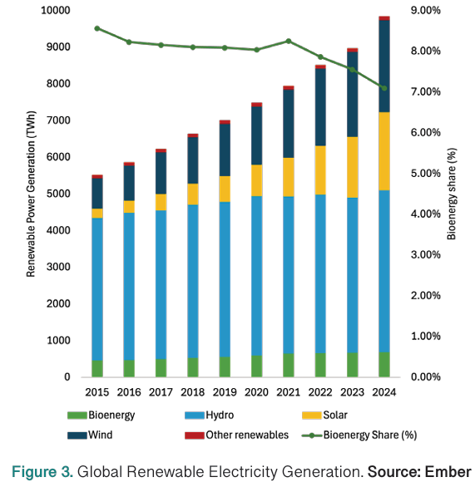
The Role in the Electricity Production is lower
Source: WBA, 2025, Global Bioenergy Statistics 2025

Slide 24
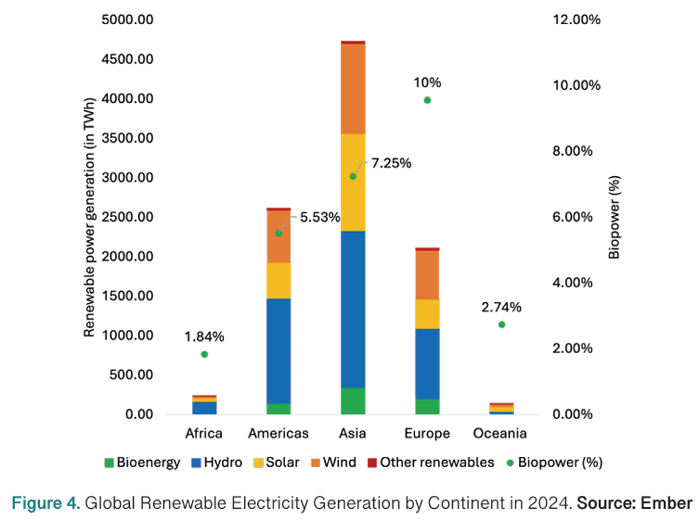
The Production of Renewable Electricity in Different Parts of the World
Source: WBA, 2025, Global Bioenergy Statistics 2025

Slide 25
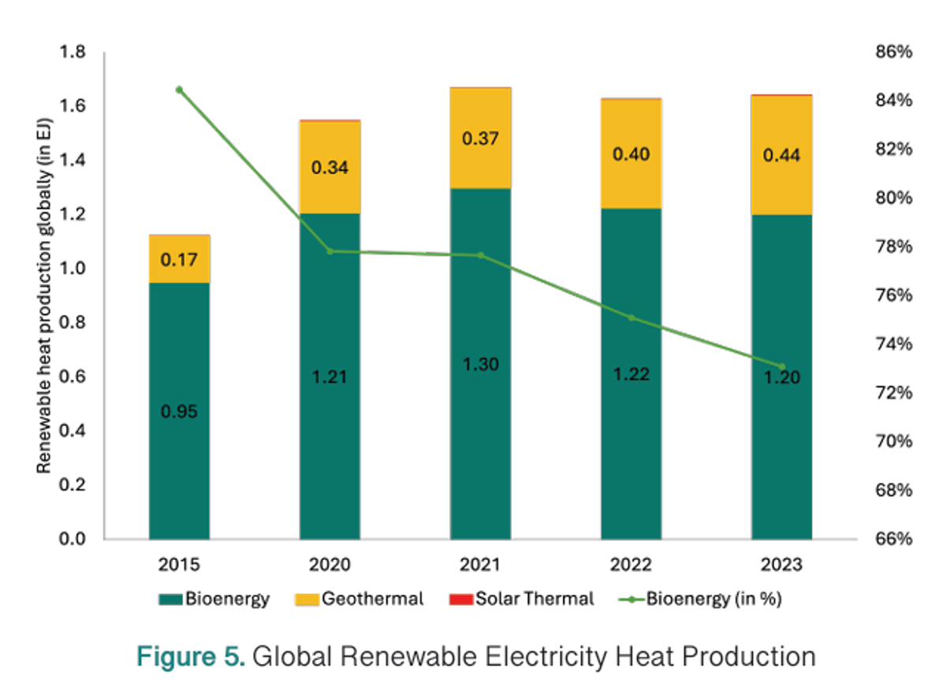
The Production of Renewable Heating in the World 2000 - 2023
Source: WBA, 2025, Global Bioenergy Statistics 2025

Slide 26
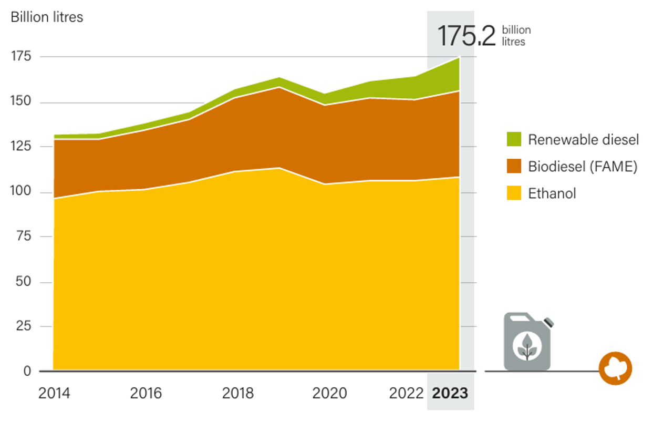
Liquid Biofuels 2013 - 2023
Source: REN21, 2025, the Renewables 2025 Global Status Report (GSR)

Slide 27
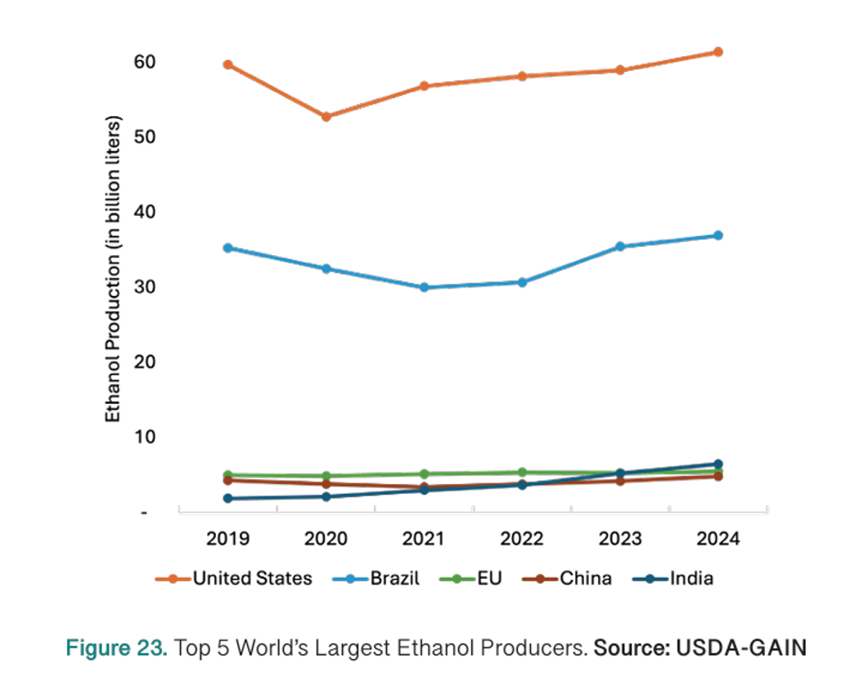
The Largest Producers of Bioethanol 2014 - 2023
Source WBA, 2025 Global Bioenergy Statistics 2025

Slide 28
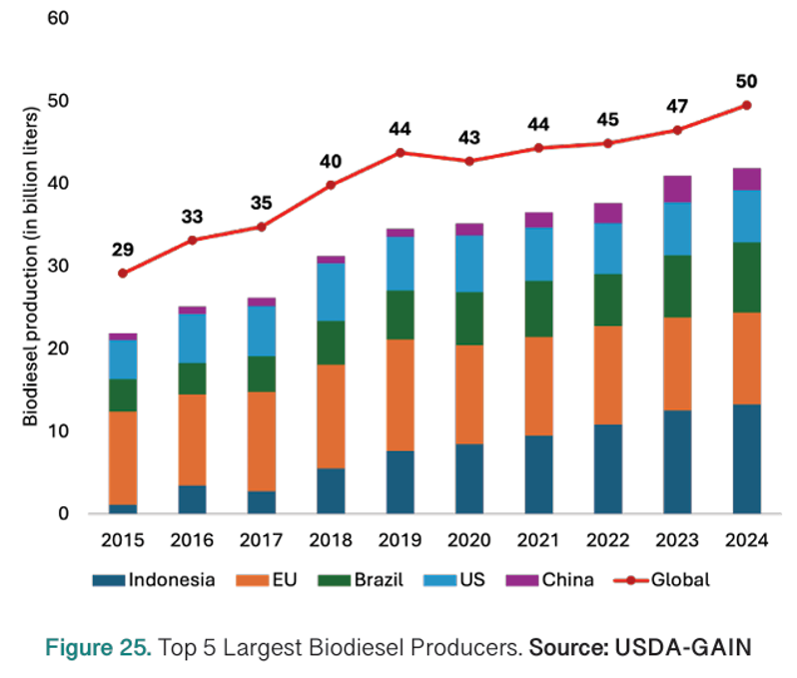
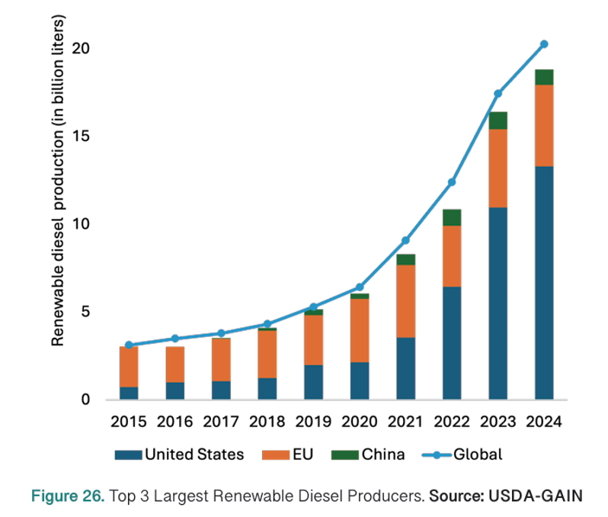
The Largest Producers of Biodiesel and Renewable Diesel
Biodiesel:
Uusiutuva diesel (HVO):
Source: WBA, 2025, Global Bioenergy Statistics 2025

Slide 29
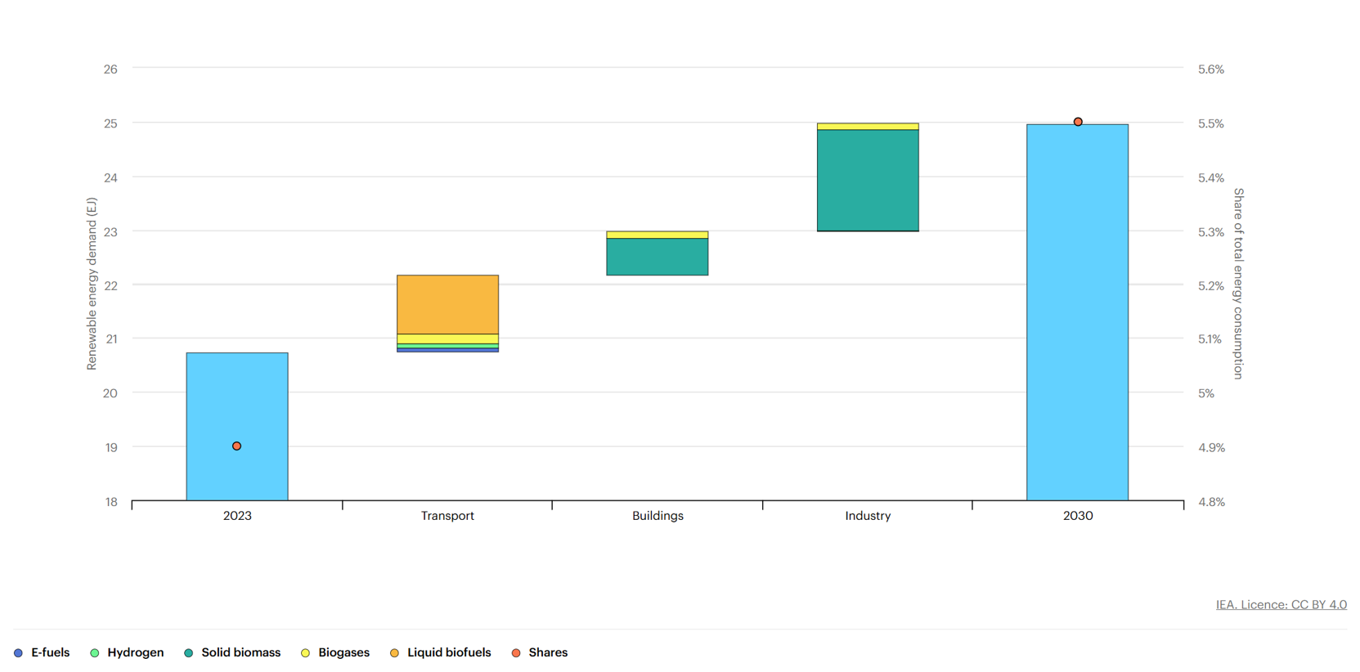
The Growth of Renewable Fuels by Sector 2023 - 2030
Source: IEA, 2024, Renewables 2024, IEA, Paris

Slide 30
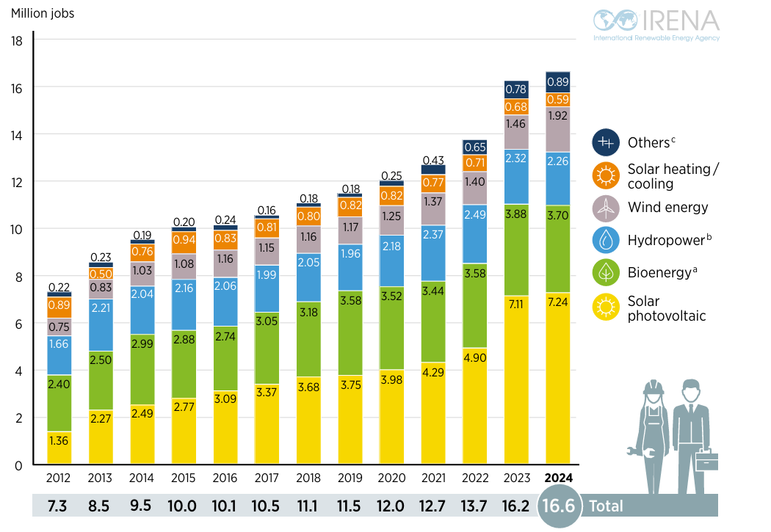
Jobs in Renewable Energy 2012-2024
Source: IRENA, 2025, Renewable Energy and Jobs, Annual Review 2025

Slide 31
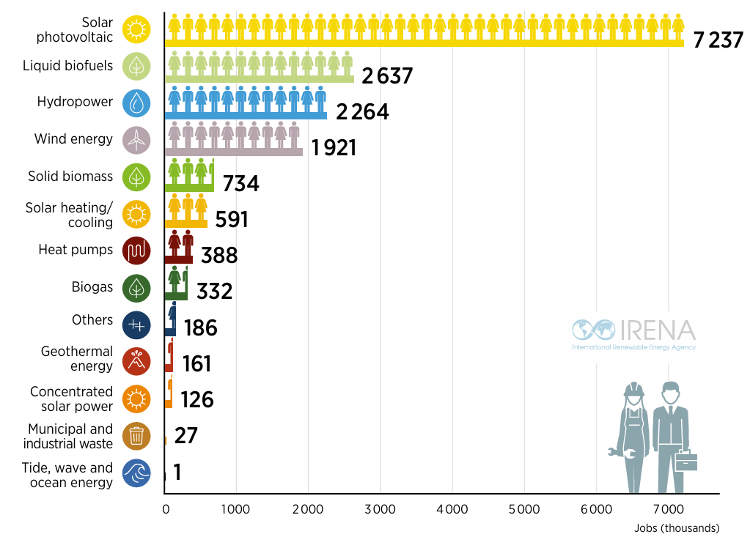
Jobs in Renewable Energy 2024
Source: IRENA, 2025, Renewable Energy and Jobs, Annual Review 2025

